Slide 2
WHO ARE WE
Notes:
Well- we are you. To be more specific: Represent students from all falcuties. We aim to have student rep from each school, so after this presentation and you see if this is something you enjoy, please hit us up.

Slide 3
OUR PURPOSE
“The student union’s purpose is to work towards and create conditions for students studying at JU where they are included, supported, and safe in their student life. “
Notes:
Three maint points Included Supported Safe

Slide 4
JSU
HI TECH
JU Level
Faculty Level
LOK
Hälsosektion
JSA
Notes:
So how else are we related to each other? Through your generals. They spend most their majority time at their school, but part of their work is with the Union so that we can hear your opinions from all faculties.

Slide 5
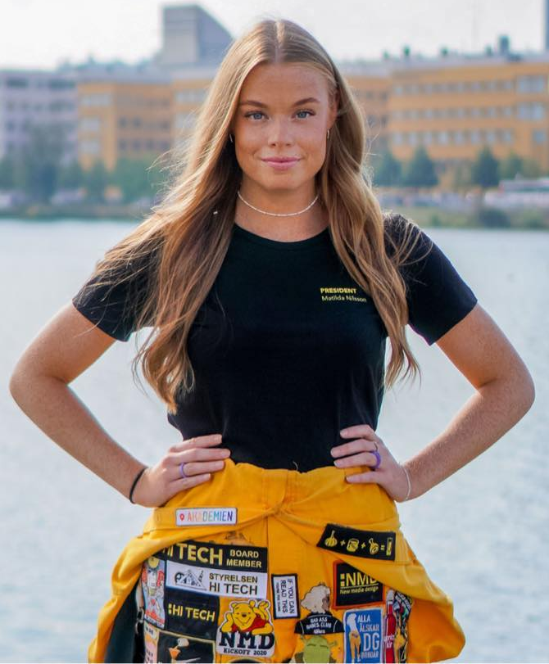
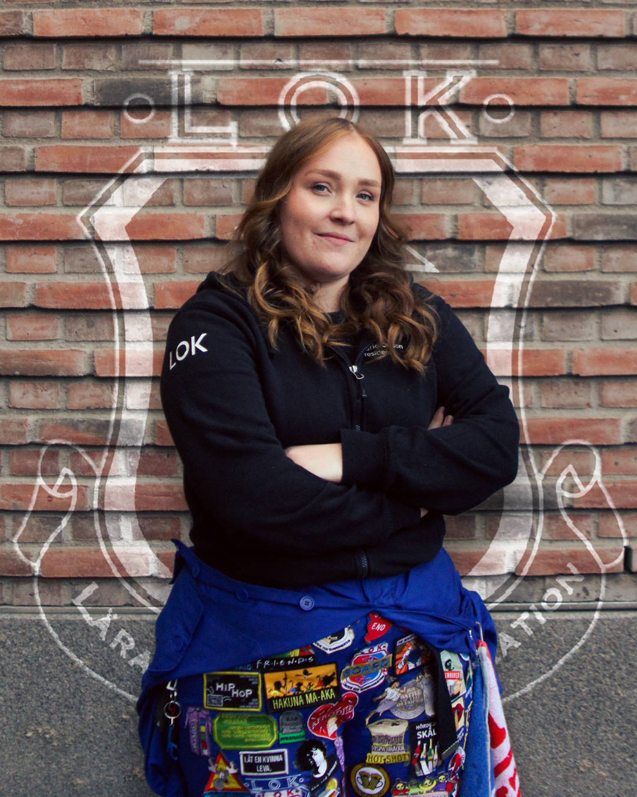
Student associations

Slide 6
Who works at the Union?
7 Renumerated
1 President
1 Vice President
1 Project Leader
4 JSU Generals – one for each Student Association
Total of 9 employees
JSU Board- but they work in a different way
JSU Presidium
Notes:
Organization structure of student union ? It sits in the board of JU Foundation has a strong voice etc. (Your story like you came for your studies from Vietnam and how you became the student union president and the experience and learning etc. so they can feel they can be that story too 😊
Can anyone plan to become or apply for positions at Student Union such as being a president etc.

Slide 7
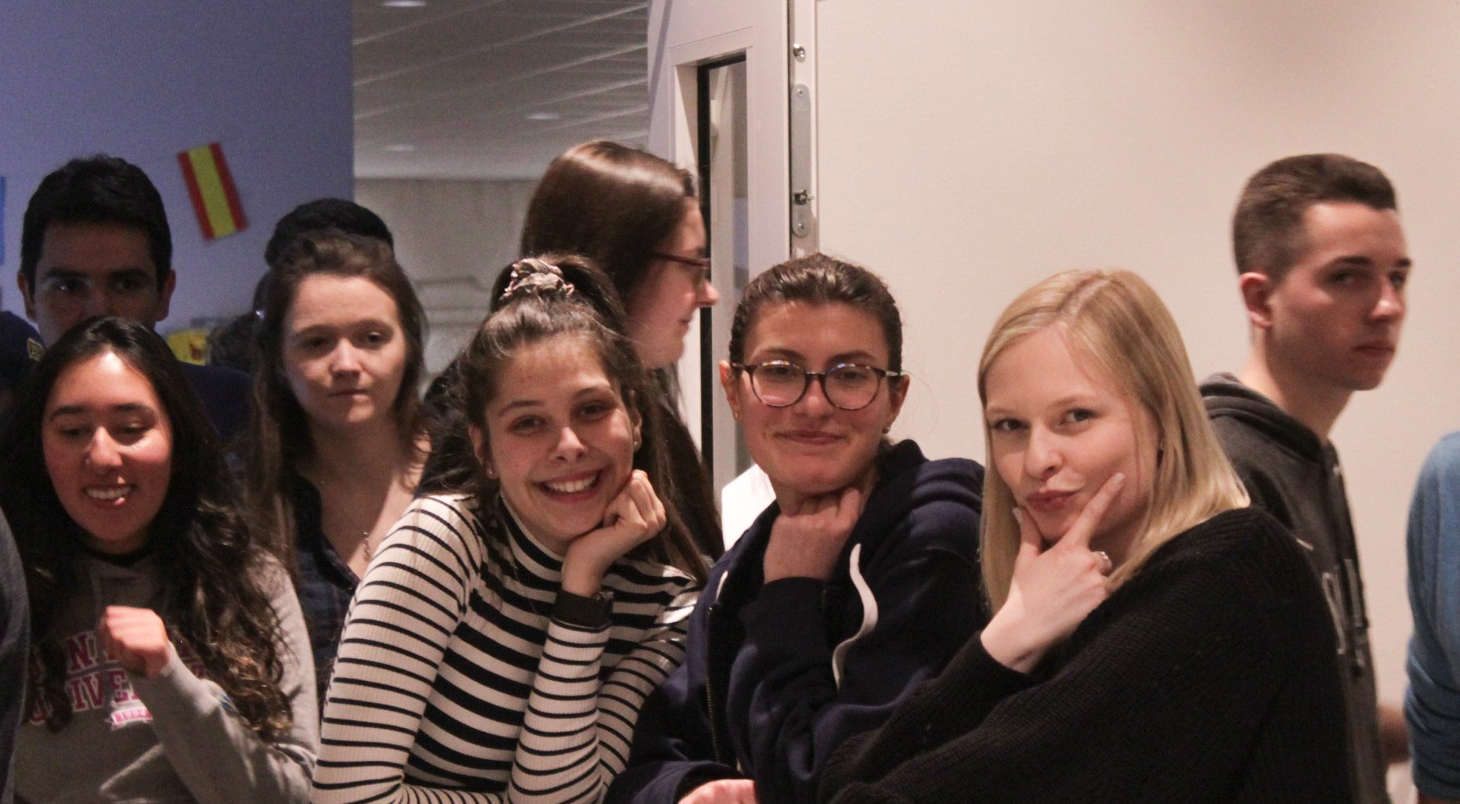
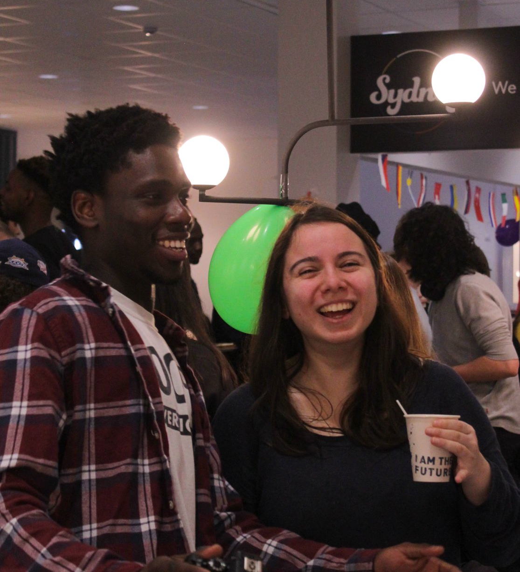
IAC

Slide 8
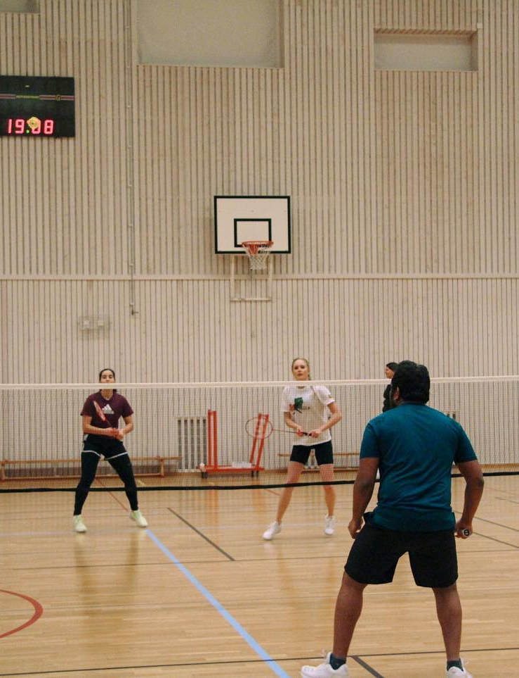
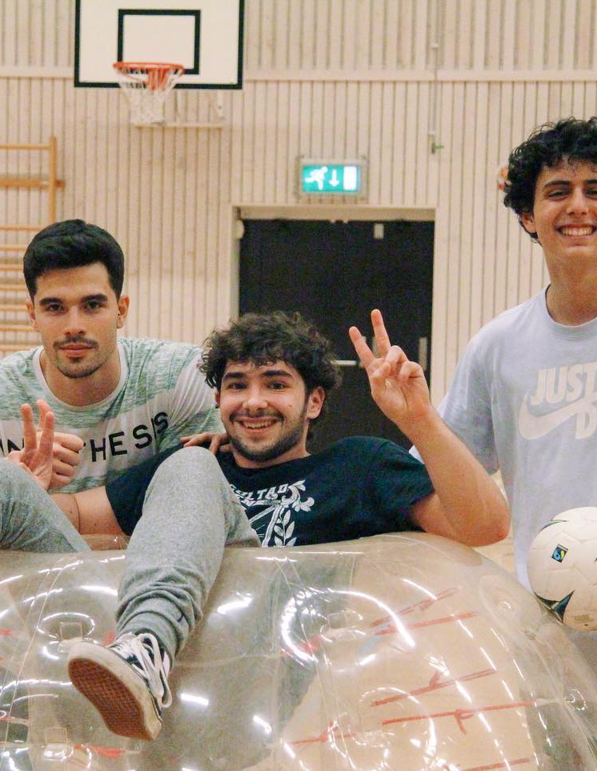
JUSA

Slide 9
AssociationS

Slide 10
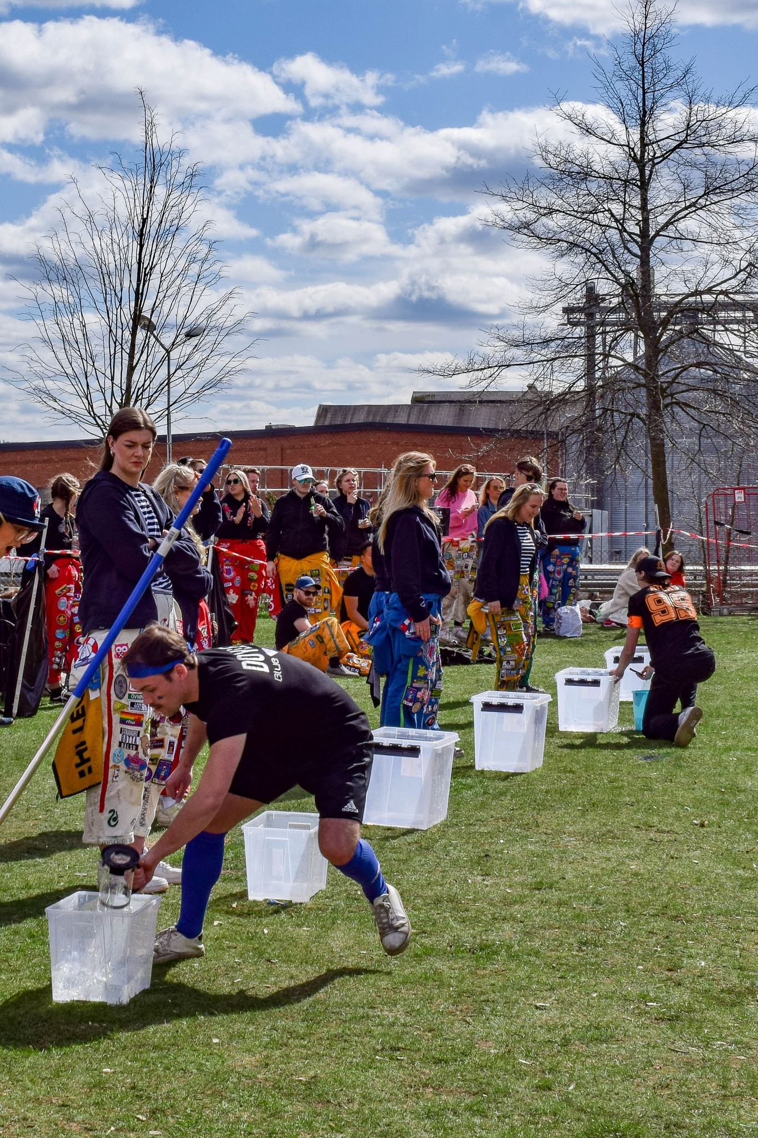
Kick-off and other events
Notes:
Explain about some exciting projects around integration?
What is a buddy program?
The Cultural Exchange Program?
https://www.youtube.com/watch?v=8UiocjmP2Aw&ab_channel=jonkopingsstudentkar

Slide 12
You find us at……
http://www.jonkopingsstudentkar.se/
@Jönköpings Studentkår
@Jönköpings Studentkår
@JKPGstudentkar
@JUstudent

Slide 13
You will also find us at…..
This KICKOFF!
In the Student House
Everywhere and anywhere!

Slide 14
By Students, For Students

