Slide 1

Om förändrings-ledarskap

Slide 2
Without changing our patterns of thought, we will not be able to solve the problems we created with our current pattern of thought.
Albert Einstein

Slide 3
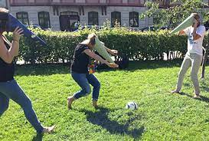

“The format are defined by the contours we see”.

Slide 4
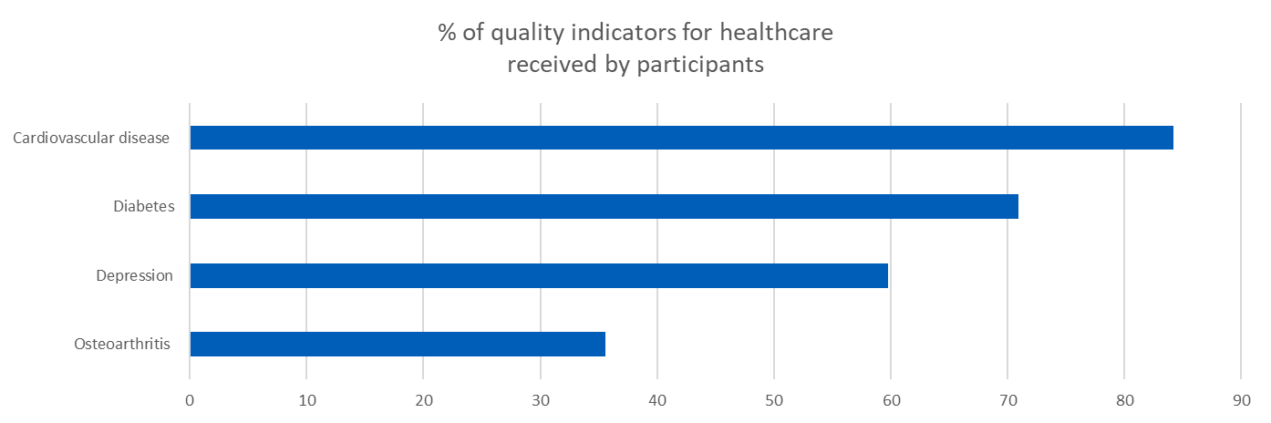


The challenge in numbers as a HCsystem
% of quality indicators for healthcare received by participants
Cardiovascular disease
Hardcastle, A.C. et al. The dynamics of quality: a national panel study of evidence-based standards 2015
Diabetes
Depression
Osteoarthritis
0 10 20 30 400 50 60 70 80 90
Healthcare represents a paradox. While change is everywhere, performance has flatlined: 60% of care on average is in line with evidence- or consensus-based guidelines, 30% is some form of waste or of low value, and 10% is harm. The 60-30-10 challenge has persisted for three decades.
Despite impressive gains, notable shortcomings
persist in normalising consistent, high-value, person-centered care. What is primarily missing is not progress in measurement, but progress in results. Changes in culture, investment, leadership, and even the distribution of power are even more important than measurement alone”
D’Avena A, Agrawal S, Kizer KW, et al.: Normalising High-Value Care: Findings of the National Quality Task Force. 2020
Braithwaite and Glasziou May 2020
Notes:
Braithwaite . Glasziou https://bmcmedicine.biomedcentral.com/articles/10.1186/s12916-020-01563-4
Hardcastle, A.C. et al. The dynamics of quality: a national panel study of evidence-based standards. Health Services and Delivery Research. 3(11) April 2015

Slide 5
1 county, 13 municipalities 130 statistical areas
Children (0-17) that lives in financial vulnerability
https://app.powerbi.com/view?r=eyJrIjoiMzNiNGQzN2EtMzc5ZC00NjFmLWJkYjItZjVhZjYyOTNlNjQ0IiwidCI6Ijg4MjY3ZjlmLTk5ZjEtNDc3Yi04NDhmLWFkNDZiMzkwYjQ0NyIsImMiOjh9

Slide 6
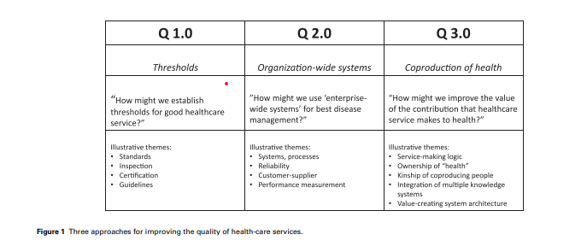
Quality as the strategy – in a moving context
The timeline
of Jönköping
1990 1995 2000 2005 2010 2015 2020 2025
A multidimensional quality model: an opportunity for patients, their kin, healthcare providers and professionals to coproduce health. Peter Lachman, Paul Batalden, Kris Vanhaecht 2022 f1000research.com/articles/9-1140

Slide 7


All changes are not improvements but
All improvements are changes

Slide 8
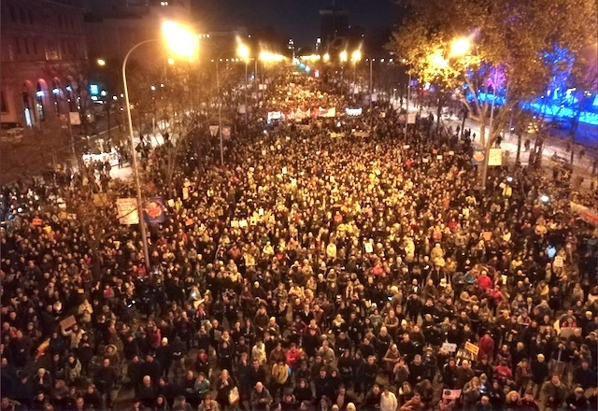

”The fear is that people still do not know what is going on!” …Greta in Madrid
A person or leader who finds gaps and reminds us of gaps changes the game

Slide 9
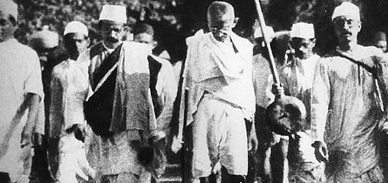
You must be the change you wish to see in the world.
M.K. Ghandi

Slide 10

A person or leader who finds gaps
and reminds us of gaps changes the game

Slide 11
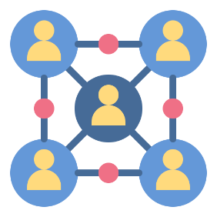




Which tradition(s) of change?
Bodies of Knowledge
Leading improvement and change in organizations and systems
Social movement theory and practice
Source: Helen Bevan

Slide 12
Which tradition(s) of change?
Bodies of Knowledge
Systems thinking
Person-centred approach
Data-driven decision-making
Leading improvement and change in organizations and systems
Social movement theory and practice
Source: Helen Bevan

Slide 13
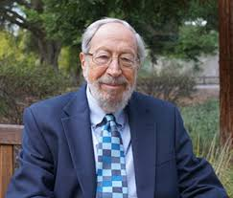
Purpose and prepare
Reaching extraordinary results
Improving capability
Value the readiness
Develop Adaptive moves
Preface of key importance
Ref: Edgar Schein
and Marjorie Godfrey

Slide 14

Quinn shows how anyone can enter the fundamental state of leadership by engaging in the eight practices that center on the theme
reflective action
authentic engagement
appreciative inquiry
grounded vision
adaptive confidence
detached interdependence
responsible freedom
tough love

Slide 15
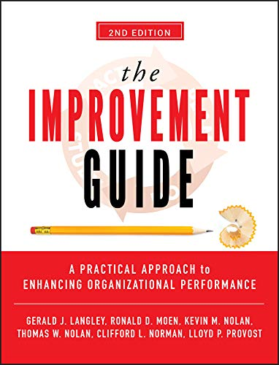
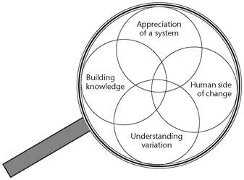

Slide 16
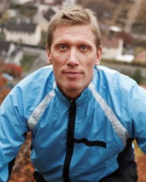
Change the Balance of Power Q 3.0
Ryhov Hospital in Jönköping had traditional hemodialysis and peritoneal dialysis center.
But in 2005, a patient, Christian, asked about doing it himself.

Slide 17
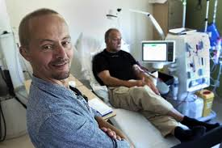
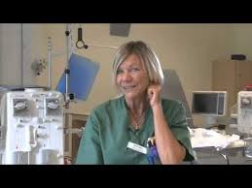

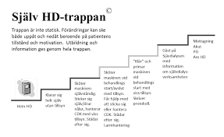
A person or leader who finds gaps and reminds us of gaps changes the game
When lives drives service

Slide 18

A person or leader who finds gaps and reminds us of gaps changes the game
When lives drives service

Slide 19

A transformational leader will develop
plan of action,
mobilize the workforce, and
unleash power by vocalizing the core values of the system.
their source of credibility is their behavioral integrity

Slide 20
